Slide 1
Image Compression Using Seam Carving
Presented By:
Shreejit Bhattarai
w10122321
Dr. Bikramjit Banerjee
CSC 638 Advanced Computer Algorithms

Slide 2
Problem Statement
Due to the increasing growth and demand of multimedia, image resizing has become a prominent concern in recent years because most photos aren't the exact size we require, knowing how to resize an image appropriately is critical.
When an image is resized, the pixels in the image are updated. Many image resizing algorithms resize the image as a whole without taking into account the device's storage and quality of the image.
As a result, in the field of resource-constrained multimedia devices, content-aware image compression with low computing complexity is a big challenge.

Slide 3
Solutions?
Scaling
Content Independent:
Results in distorting the contents in the image
b) Cropping
Remove pixels from the image periphery only:
Results in fully cutting out some portion from the edges

Slide 4
Introduction to Seam Carving
An algorithm for content-aware image resizing without distorting or even cropping the image.
Pixels added or removed based on the low-energy areas of the images.
(This means that the contents i.e, in this case the pixels to add or remove are particularly picked based on the content of the image itself. These are typically called the “low-energy” areas of the images.)
Seams are formed to create paths of least importance.
(Seams are formed to create paths of least importance, either horizontal or vertical seams, within the image, and later on helps remove those unwanted or least important seams. )
This process therefore results in either reducing the image size or expanding that image by inserting the seams.
When reducing the width of an image, seam carving looks for a vertical seam that runs from the top of the image to the bottom.
And when reducing the height of the image, seam carving looks for a horizontal seam that runs from the left of the image to the bottom.

Slide 5

What is a seam?
A seam is a connected path of low energy pixels which cross the image such as top to bottom or left to right. There is no necessity that path should be straight line only. It can be random. By successively removing or inserting a seams image can be reduced, or enlarge.
It is the seam with the help of which the image is resized by one pixel at a time either horizontally or vertically.

Slide 6
Application of Seam Carving
Responsive Web Pages
While automatically adjusting the pages for different screen sizes
2. Object Removal
3. Image Enlargement and Reduction
4. Content Amplifications

Slide 7
Approach of Resizing (For Reduction)
Step 1: Assigning energy to every pixel of the image
Step 2: Find the seam with the lowest importance or minimum cost
Step 3: Use the backtrack method to remove or delete all the pixels in the path
Step 4: Now, we repeat steps 1 to 3 till the desired numbers of columns are deleted

Slide 8
Step 1
Step 1: Assigning energy to every pixel of the image.
Energy function is quantitative measure of visual content.
Although seam carving can support several types of energy functions such as gradient magnitude, entropy, visual salience etc.
For now gradient magnitude has been used which is the most basic one, to find the energy of every pixel.

Slide 9
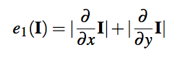
Step 1
Step 1: Assigning energy to every pixel of the image.
Energy function, e1(I) is defined over the image I as below:
Here, I is the image matrix. In simple terms, for each pixel of the image, for every channel (RGB), this equation finds the derivative in the x-axis, finds the derivative in the y-axis and finally sums their absolute value.
This gives the energy value to that particular pixel.
And, to compute the derivation Sober filter, a convolutional kernel can be used to run over the image on every channel.

Slide 10
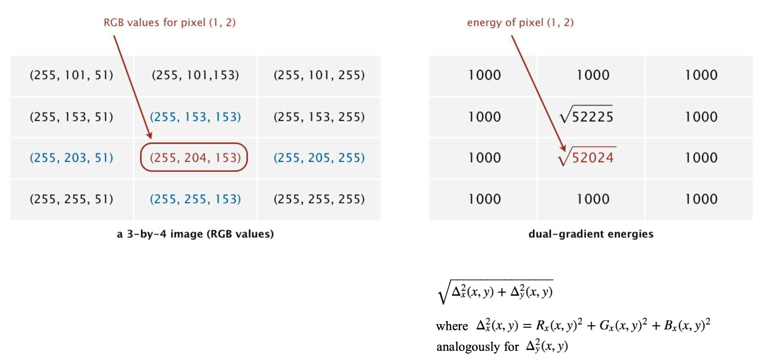
Step 1
Step 1: Assigning energy to every pixel of the image.

Slide 11
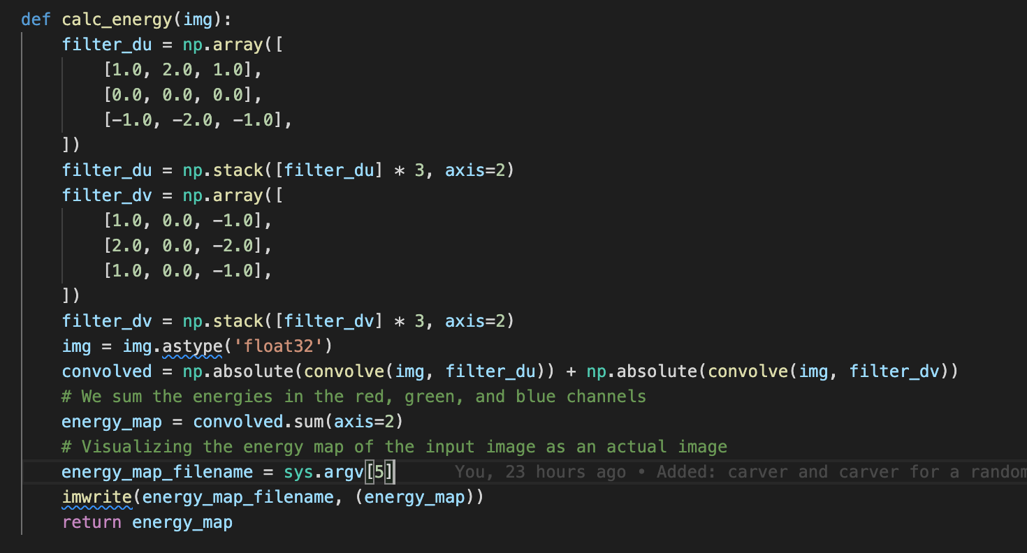
Step 1
Sober Filter to compute derivation
Code Snippet to calculate energy map:

Slide 12

Visualizing the Energy Map
Figure: Original Image

Slide 13
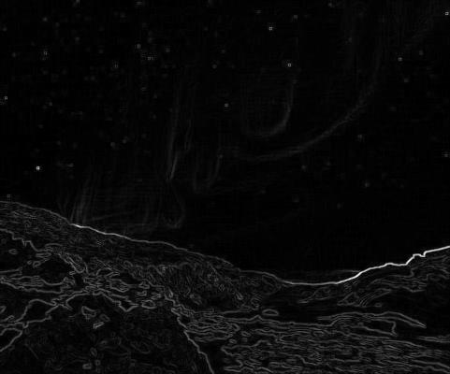
Visualizing the Energy Map
Figure: Visualization of Energy Map

Slide 14
Step 2
Step 2: Finding the seam with the lowest importance or minimum energy
Since seam is a sequence of pixels, and are exactly one per row.
Constraint: Between two consecutive rows, the 𝑥 coordinate can only vary by at most one. This keeps the seam connected.
The lowest-energy seam is the one whose total energy across all the pixels in the seam is minimized.

Slide 15
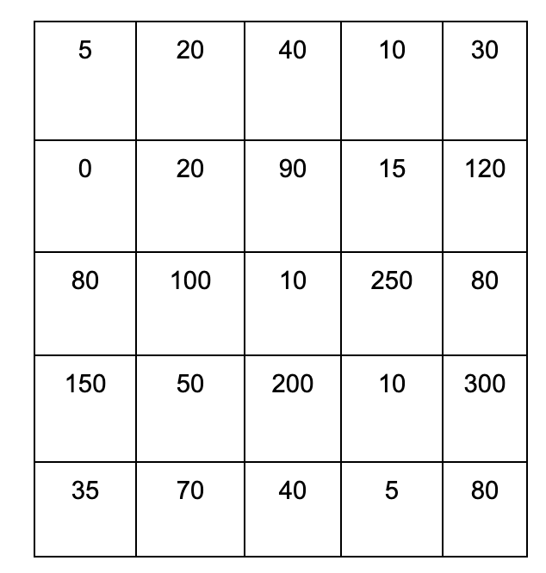
Step 2
Step 2: Find the seam with the lowest importance or minimum cost.
Options for finding the seams:
Brute Force Approach
Greedy Approach
Dynamic Programming Approach
Figure: 5*5 Energy Map of an Image

Slide 16
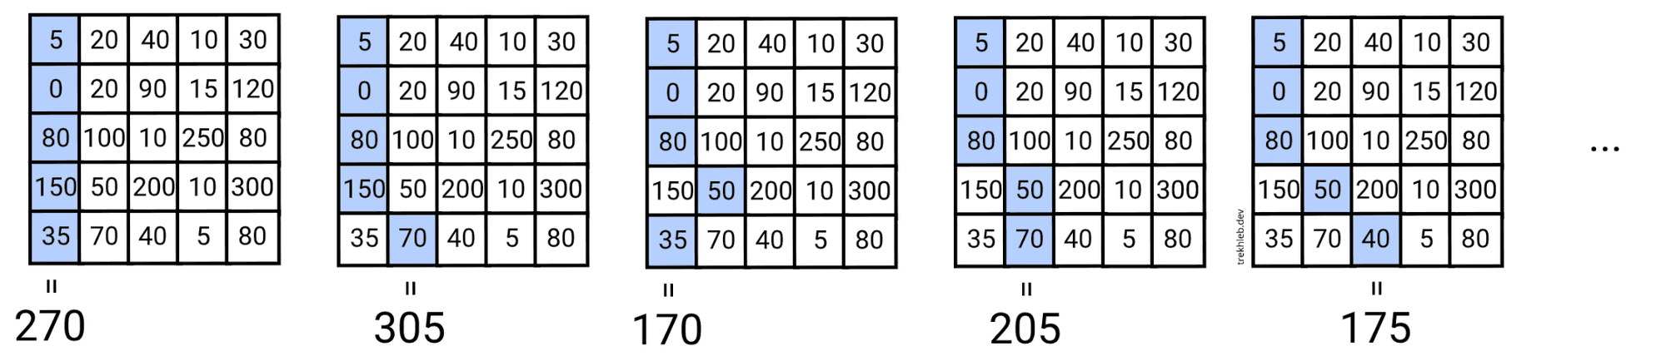
Brute Force Approach
With the brute-force approach, checking all the possible paths to find the minimum seam would be a costly approach.
Time complexity of O(3^m), since each pixel, while going from top to bottom, have 3 options (down-left, down, or down-right). Here, m is the height of the image or the total number of rows.

Slide 17
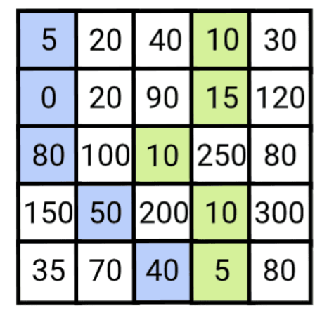
2. Greedy Approach
The greedy approach does not work. By picking a low-energy pixel early on, we get stuck in a high-energy region of the image, represented by the blue path on the right.
We can see starting at the top row and trying to pick the lowest-energy pixel in the next row doesn’t work. By going to the pixel with an energy of 5, we are forced into a high-energy region of the image.
Instead, if we had chosen to go with the higher-energy pixel at the left side of the middle row, we would have access to the lower-energy region at the bottom left.
Advantage: This approach is fast. O(m+n)
Disadvantage: Cannot guarantee it will find the best possible solution.
Optimal Path Cost: 50
Greedy Path Cost: 175

Slide 18
3. Dynamic Programming
Finding the path through the image with the minimum total energy is a direct application of Dynamic Programming.
If the width of the image is being reduced, the path will travel top to bottom and the total number of pixels in the path will equal the height of the image.
The minimum path is found by storing the optimal paths to reach each pixel in a cost table.
The table is constructed by top-down memoizing, and the path to a pixel is inferred by back-tracing through the table.
Before we have proven that the brute-force is intractable. Now, we show this seam carving problem has optimal substructure and overlapping problems.

Slide 19
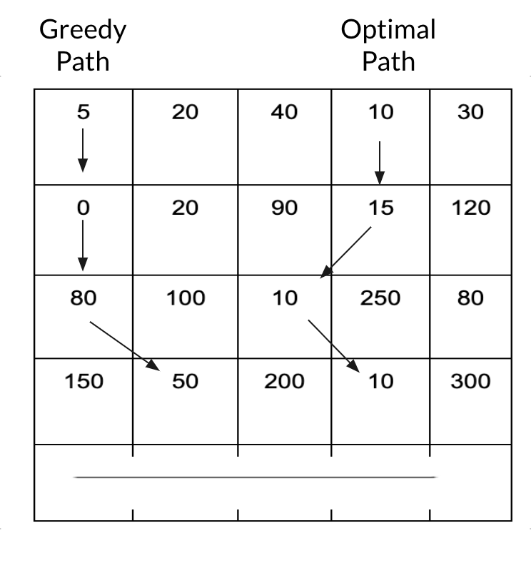
Optimal Substructure:

Slide 20
Overlapping Subproblem:
The fact that we're utilizing the previous seam's energy to calculate the energy of the current seam may be applied recursively to all the shorter seams up to the very top 1st row seam.
When sub-problems overlap, it's a hint that the overall problem could benefit from a dynamic programming approach.

Slide 21
Recurrence Relation from the Overlapping Sub-Problem
Given an energy function e, the optimal seam can be found using dynamic programming.
The first step is to traverse the image from the second row to the last row and compute the cumulative minimum energy M for all possible connected seams for each entry (i, j):
Here, M is the 2D array to store the minimum energy value seen upto that pixel.
M(i,j) = e(i,j) : If i = 0
M(i,j) = e(i,j) + min (M(i-1,j), M(i-1),j+1) : If j = 0
M(i,j) = e(i,j) + min (M(i-1,j-1), M(i-1,j)) : If j = n - 1 (no. of pixels in a row)
M(i,j) = e(i,j) + min (M(i-1,j-1), M(i-1,j), M(i-1),j+1) : o/w

Slide 22
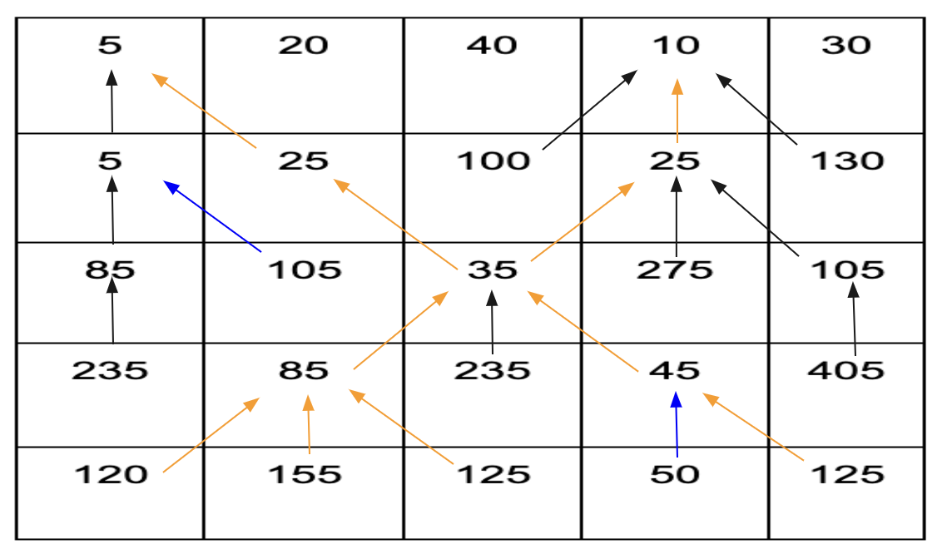
Solving the 5*5 energy-map matrix:
j
0
1
2
3
4
0
i
1
2
3
4
M*N Pixels, M = 5 and N = 5
M(i,j) = e(i,j) : If i = 0
M(i,j) = e(i,j) + min (M(i-1,j), M(i-1),j+1) : If j = 0
M(i,j) = e(i,j) + min (M(i-1,j-1), M(i-1,j)) : If j = N - 1 (no. of pixels in a row)
M(i,j) = e(i,j) + min (M(i-1,j-1), M(i-1,j), M(i-1),j+1) : Otherwise
50
Time Complexity: O(M*N)

Slide 23
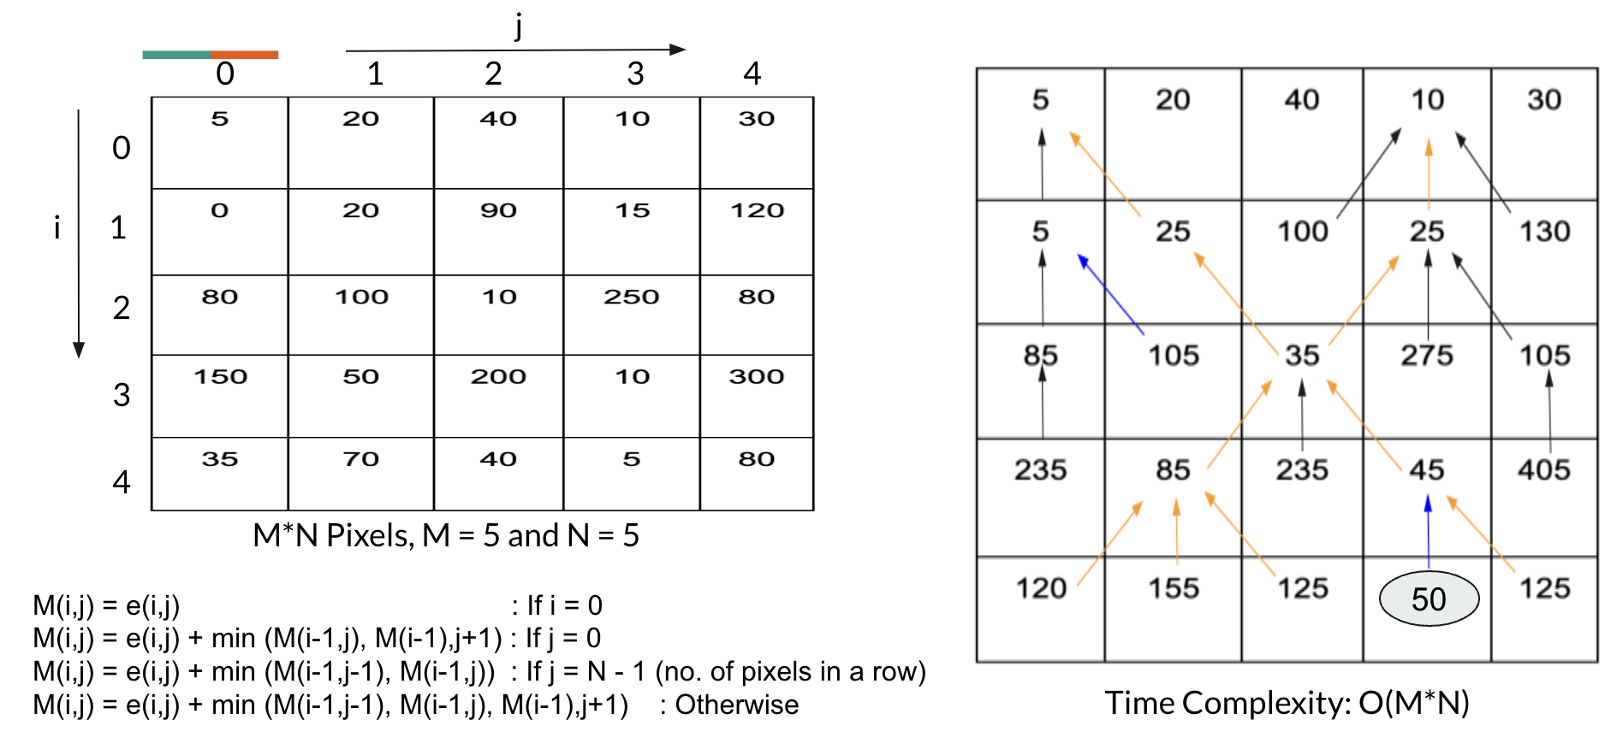
Backtracking
During the Energy Map table generation for each pixel, we may save not only the energy of the seam but also the coordinates of the previous lowest energy seam.
Backtracking from the minimum value position would then further help to find the list of pixels present in the seam. This will give us the possibility to reconstruct the seam path from the bottom to the top easily.

Slide 24
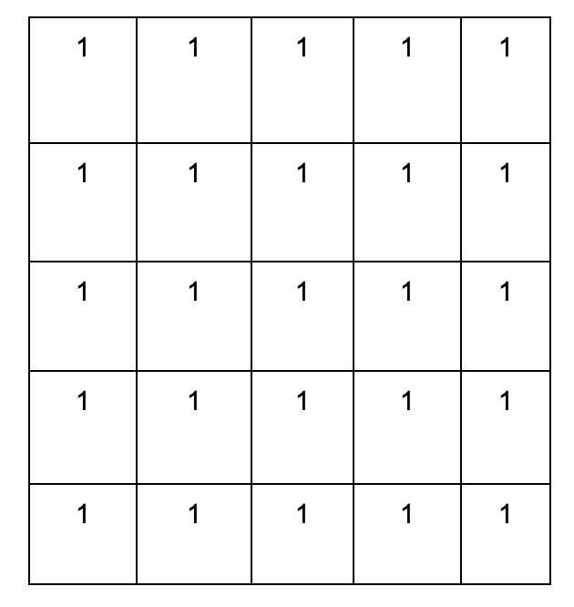
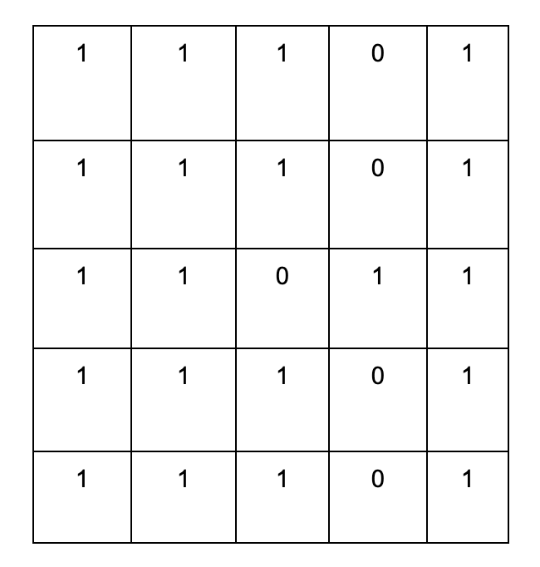
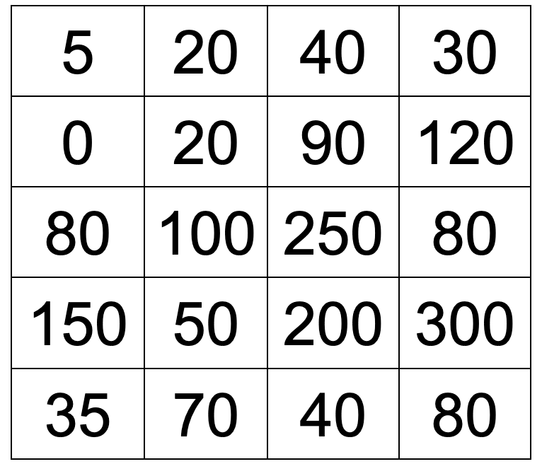
Backtracking
Mask of 5*5 (Same of original pixel in image)
Reshaping
After applying backtracking to the mask

Slide 25
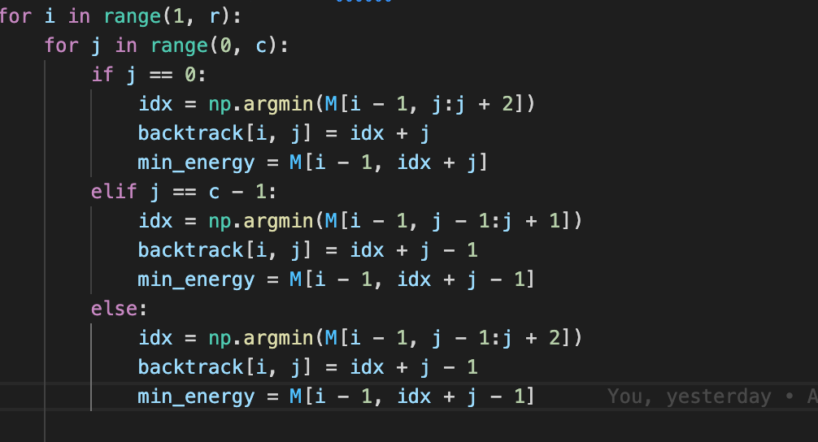
Code Snippet to calculate the minimum energy seam

Slide 26
Figure: Gif to visually illustrate how the seam carving works for image size reduction

Slide 27
References
https://en.wikipedia.org/wiki/Image_derivative
https://www.youtube.com/watch?v=6NcIJXTlugc&ab_channel=r3dux
https://trekhleb.dev/blog/2021/content-aware-image-resizing-in-javascript/

